Slide 1
Hard Label Black-box Node Injection Attack on GNN
Presenters: Zihao Dong, Guofeng Zhang, Jingchen Tang, Yu Zhou

Slide 2
Background: Adversarial Attack
White Box Attack:
The adversarial agent has access to all information of the model, including gradient, model structure, and all outputs
Soft-Label Black Box Attack:
The adversarial agent only has access to the logits output of the model, and has no knowledge about the model’s gradient and structure
Hard-Label Black Box Attack:
The adversarial agent only has access to the label output of the model, i.e. argmax(logits)
Attack on GNN:
Edge Attack & Node Injection Attack
Targeted & Non-targeted Attack

Slide 3
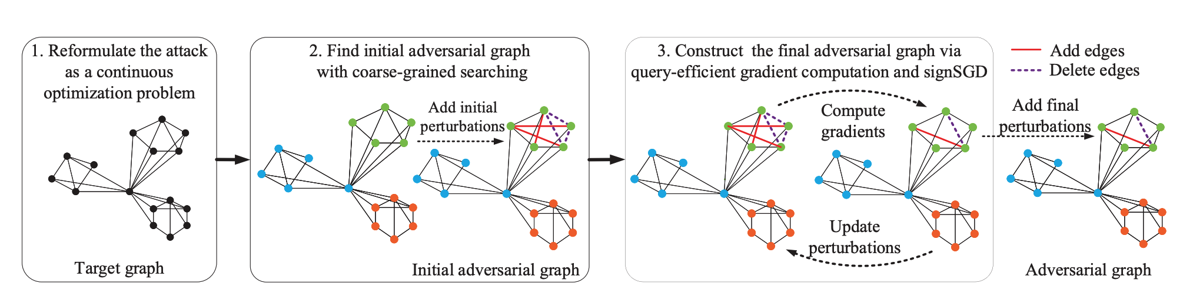
Reference Paper: Hard-Label Edge Attack
Given a target GNN model 𝑓 and a target graph 𝐺 with label 𝑦0,
Attacker attempts to generate an untargeted adversarial graph 𝐺 ′
By perturbing the adjacency matrix 𝐴 of 𝐺 to be 𝐴 ′ (Edge Perturbation)
The predicted label of 𝐺 ′ will be different from 𝑦0

Slide 4
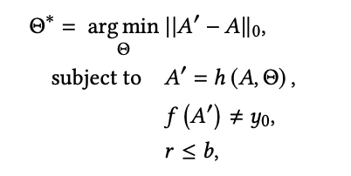
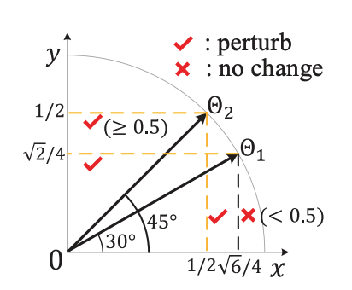
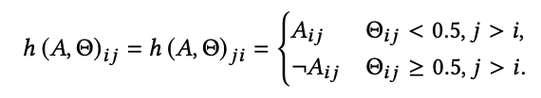
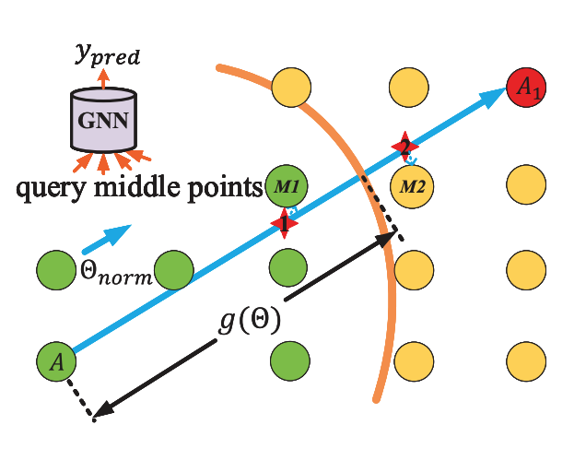

Optimization Problem
Θ matrix
𝑔 (Θ) measures the distance from the original graph 𝐴 to the classification boundary
computed via repeatedly querying the target model

Slide 5
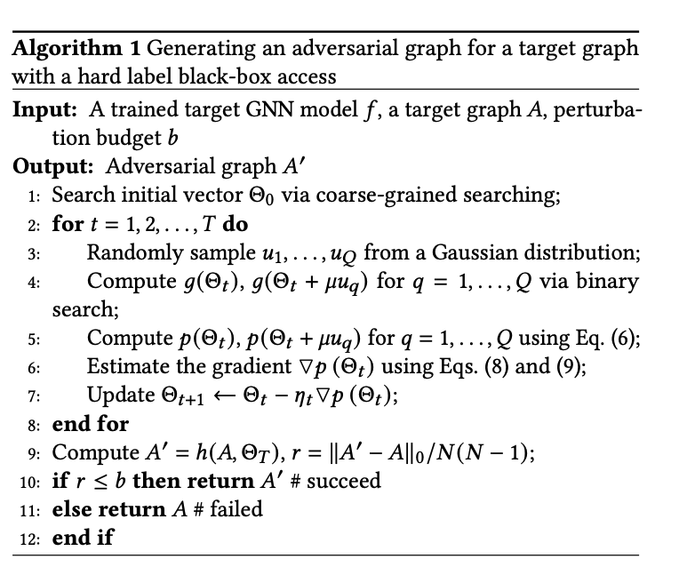

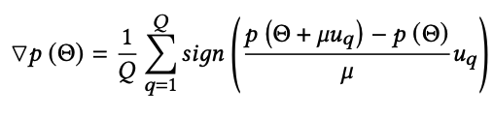
Optimization Problem (Cont.)
𝑔_hat(Θ) denotes a distance vector which starts from 𝐴 and ends at classification boundary at the direction of Θ with a length of 𝑔(Θ)
𝑝 (Θ) denotes the number of elements of 𝑔_hat(Θ) that exceed 0.5
signSGD to solve the optimization problem

Slide 6
Our Approach - General Idea
Goal:
extend the above paper’s method to a Hard Label Black Box Node Injection Attack.
To the best of our knowledge, this will be the very first Hard Label Black Box Node Injection Attack on GNN
Method:
“Leave room for new nodes”, try inject 1, 2,…, n nodes iteratively,
until success or exhaust our budget
Note:
we add the iterative approach to some of the datasets because of the randomness in some of our approaches

Slide 7
Single Node Injection Attack
Inspired by Single Pixel Injection Attacks on computer vision models (Su et al, 2017), we first attempt a single node injection attack on Graph Classification GNN models.
In this part, we allow edge perturbations on both the original graph and the injected node to maximize attack success rate.
Reference: https://arxiv.org/pdf/1710.08864.pdf

Slide 8
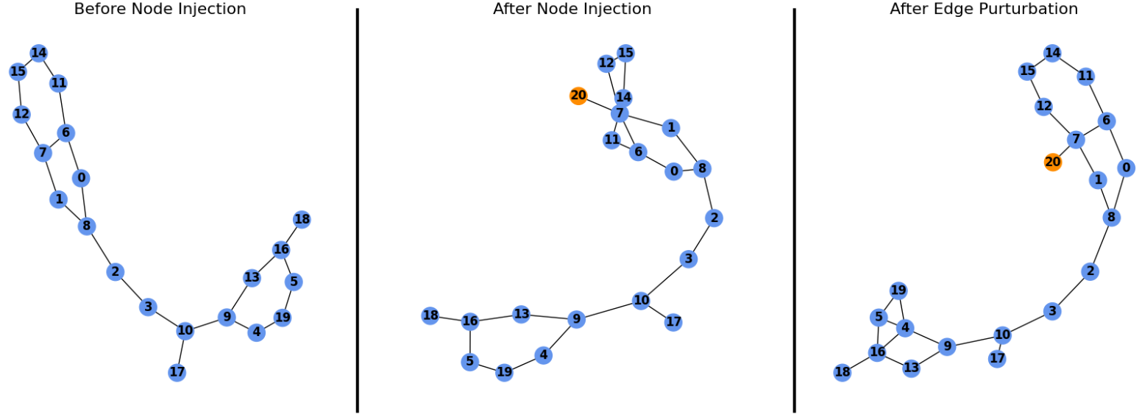
Single Node Injection Attack
Nodes 4 and 5 are connected and the connection between nodes 7 and 11 was removed

Slide 9
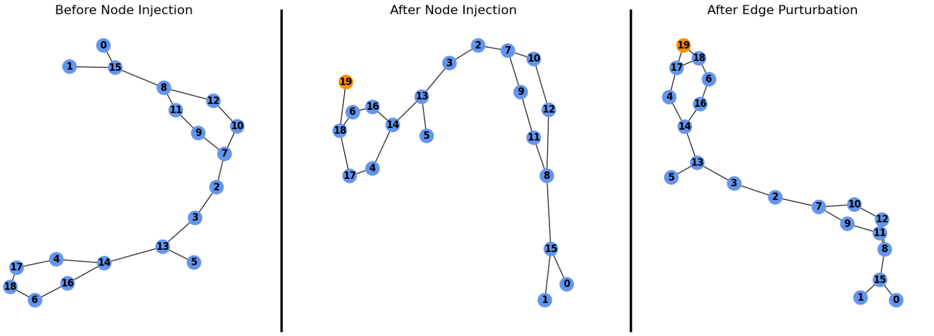
Single Node Injection Attack
Node 17 and the injected node 19 are now connected

Slide 10
Details of Single Node Injection Attack
We use two different feature initialization methods for the injected node: 1. Mean (average of all nodes) 2. Random (random value in the range of all node values)
We also consider two methods for connection the injected node to the graph: 1. Random Node (connect to a random node) 2. Mode Node (connect to the node with highest rank)

Slide 11
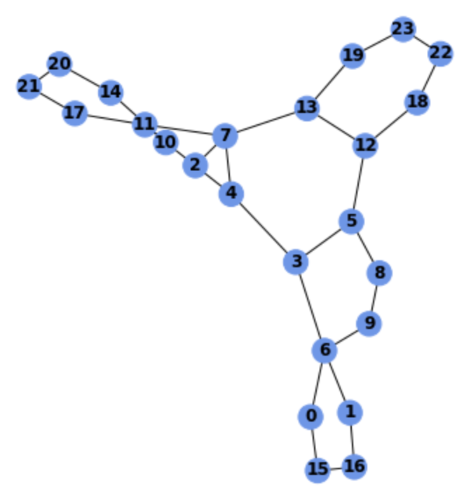
NCI1 Dataset
Chemical Substance Structure Graphs
feature initialization | Connection method | Success Rate (SR) | Success Count | Average Perturbation (AP) | Average Attack Time (AT)
mean | Mode node | 80.00% | 232 | 4.3707 | 56.6134
mean | Random node | 81.3559% | 240 | 5.1250 | 37.4665
random | Mode node | 81.7568% | 242 | 5.8595 | 37.7517
random | Random node | 83.5570% | 249 | 5.6113 | 39.5264
Reference paper best SR: 78%
Classification Model being attacked: GIN by (Xu et al, 2018)

Slide 12
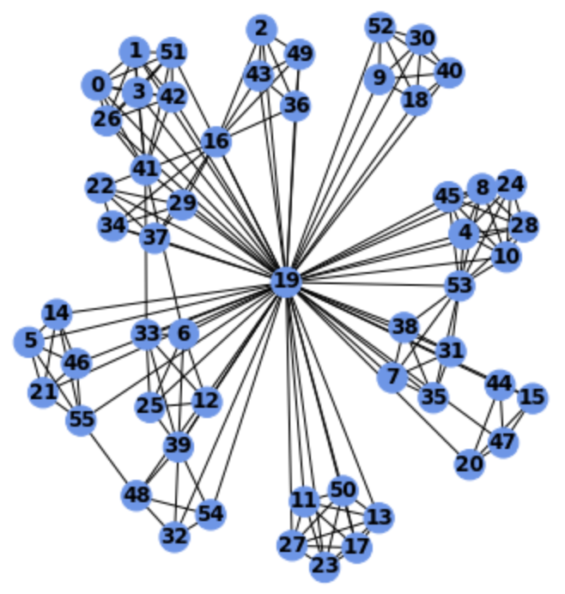
IMDB-BINARY Dataset
Social Network Graphs
feature initialization | Connection method | Success Rate (SR) | Success Count | Average Perturbation (AP) | Average Attack Time (AT)
mean | Mode node | 98.6111% | 71 | 30.0563 | 30.3956
mean | Random node | 98.6111% | 71 | 30.9155 | 32.2228
random | Mode node | 97.2222% | 70 | 31.0571 | 30.2109
random | Random node | 98.6111% | 71 | 30.6338 | 32.4291
Reference paper best SR: 89%

Slide 13
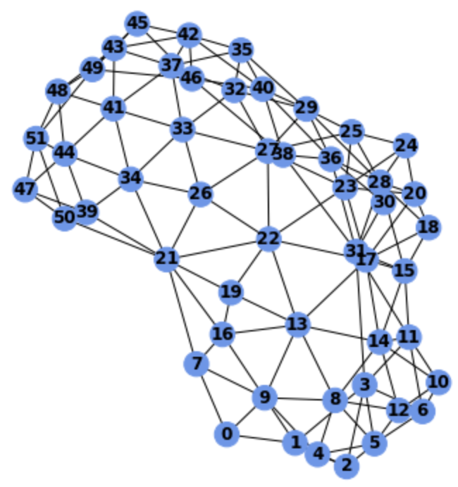
COIL-DEL Dataset
Image Features as fully-connected Graph
feature initialization | Connection method | Success Rate (SR) | Success Count | Average Perturbation (AP) | Average Attack Time (AT)
mean | Mode node | 97.4522% | 306 | 3.509 | 26.32
mean | Random node | 97.1246% | 304 | 3.514 | 42.91
random | Mode node | 97.3510% | 294 | 3.235 | 29.22
random | Random node | 97.7199% | 300 | 3.632 | 26.99
Reference paper best SR: 92%

Slide 14
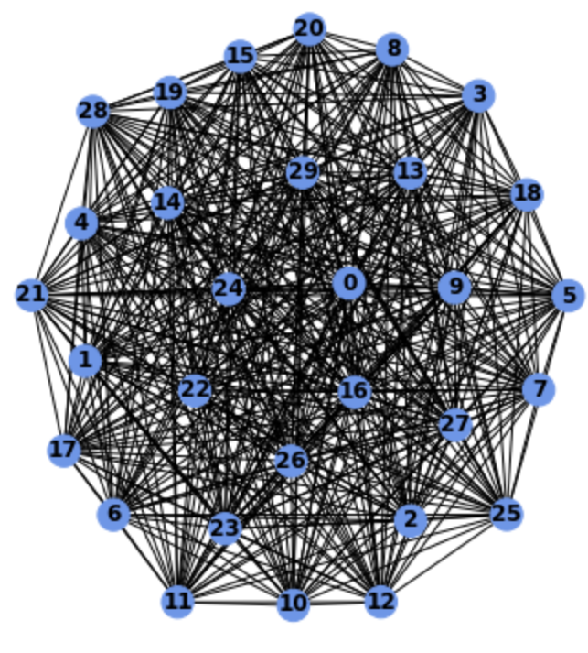
Limitations of this method
In practice, it may not be feasible to perturbe edges in the original graph. For example in social networks, the attacker is only able to modify edges (follow relationships) on the injected node (new user created by attacker), but not the relationships of existing users.
For large complex graphs and datasets with small number of labels, injecting only a single node has little effect on the whole graph, so we end up having to perturbe a very large number of edges

Slide 15
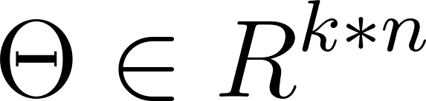
Our Approach - Detail
When trying to inject k nodes:
Initialize k node features, and simply put the new nodes into the node list of the graph
Initialization method may vary across datasets (will introduce later in experiments)
Initialize the initial connection, i.e. connect the new nodes to some original node, otherwise they have very small influence on the graph
Connection Initialization method can be: connect to node with highest degree, or randomly choose a node
“Cut” the Adversarial Perturbation Matrix (Θ) to only the entries involving the new nodes:
Rest of the algorithm will be the same as the original paper (i.e. we perform direction search and binary search along the chosen direction like the original paper to find the decision boundary)

Slide 16
Performance of Multi-Node Injection
Some Key Challenges:
Initialization of node feature
How to enforce the injected node can keep connected to the graph after perturbing the edges?
In this sets of experiments we will explore the effect of different feature initialization and connection initialization methods
Because of limit of computation resource, we only had chance to finish experiments using GIN

Slide 17
COIL-DEL Dataset
Node Feature: (x, y) coordinates, where x and y are integers but represented as floats (1.000, 5.000, etc)
No two nodes have same coordinates in this datasets, therefore our initialization is a Gaussian Dist whose mean and std are from original node features (because of randomness, non iterative)
Connection Init: random vs mode (node with highest degree)
method | budget | SR% | success | Injected % | No need | Pred change | Perturb edge
mode | 0.1 | 50.35 | 94 | 99.16 | 102 | 51 | 13.51
mode | 0.15 | 63.89 | 112 | 100 | 102 | 72 | 11.57
random | 0.1 | 48.68 | 100.2 | 100 | 102 | 40 | 15.51
random | 0.15 | 61.46 | 122 | 100 | 102 | 55 | 17.38

Slide 18
IMDB-BINARY
The node features are just [1.]’s, so node feature initialization is trivial; because initialization is deterministic, we will try to reduce perturbation by employing the iterative approach
method | budget | SR% | success | Injected % | No need | Pred change | Perturb edge
mode | 0.1 | 27.63 | 7 | 100 | 24 | 14 | 167.1429
mode | 0.15 | 53.95 | 20 | 100 | 24 | 21 | 104.4
random | 0.1 | 27.63 | 6 | 100 | 24 | 15 | 191.67
random | 0.15 | 51.32 | 20 | 100 | 24 | 19 | 111.58

Slide 19
NCI1
Node Feature: 37-dim 1-hot encoding of atom type
Node Feature Init: count each atom type, and generate new atom following a probability based on the counts (i.e. the prob of generating atom x will be p = count(x)/#atom), non iterative
method | budget | SR | success | Injected % | No need | Pred change | Perturb edge
mode | 0.1 | 47.43 | 101 | 99.17 | 104 | 44.6 | 128.17
mode | 0.15 | 63.19 | 140 | 98.82 | 104 | 54 | 165.06
random | 0.1 | 41.04 | 101 | 100 | 104 | 25 | 143.63
random | 0.15 | 54.40 | 140 | 100 | 104 | 27 | 185.53

Slide 20
For IMDB and NCI1
Notice the perturbation count in these 2 datasets
Our method needs further improvement on these 2 datasets

Slide 21
Feature Manipulation of injected nodes
Algorithm:
Find the node that has most connections in the original graph and its feature.
Find the feature in current graph that has the largest L1 distance to the feature of the node in step 1
Slightly perturb the feature in step 2 such that it is not the same to any feature in graph (or to other injected nodes)
Connect injected node to the node find in step 1
Iterate to find best perturbations (Limited to injected nodes)

Slide 22
Performance of feature manipulation
Experiments are only currently conducted on COIL dataset
 | Success rate | Edge perturbation | Attack time | Query count
10% | 48.61 | 10.84 | 9.06 | 544.2
10% (I) | 48.95 | 8.25 | 11.1 | 580.8
15% | 63.89 | 10.65 | 9.56 | 644.0
15% (I) | 64.24 | 8.65 | 13.2 | 786.6
20% | 71.18 | 11.88 | 9.74 | 632.0
20% (I) | 71.53 | 9.39 | 15.7 | 822.8

Slide 23
Demo

Slide 24
Future works and discussions
Investigate more concrete optimization process of finding injected feature of nodes
Find better connection initialization that is less noticeable. (more than one edge/node?)
Create initial search as in original paper to improve the success rate and speed up the attach
Improve our methods on datasets like IMDB and NCI1, which have small number of prediction classes
Test our model on more graph classification datasets

